Slide 1
Oscar nomination Prediction
ISM 6136 : Data Mining Project
Project By –
Murtaza Husain
Anusman Panda
Akash Gandhi

Slide 2
MOTIVATION:

Slide 3
Why this topic?

Slide 4
Why this topic?

Slide 5
Data Collection through web scraping
We have collected data from below sources to grab details of Movies which includes attributes such as genres,ratings,budget and collection.
IMDB All best picture Oscar nominated movies-IMDB oscar nominated movies list
IMDB Greates movies from 2000-2017-IMDB 2000-2017 greatest movies
To capture budget and worldwide collection-Movies budget
For other details-Wikipedia

Slide 6
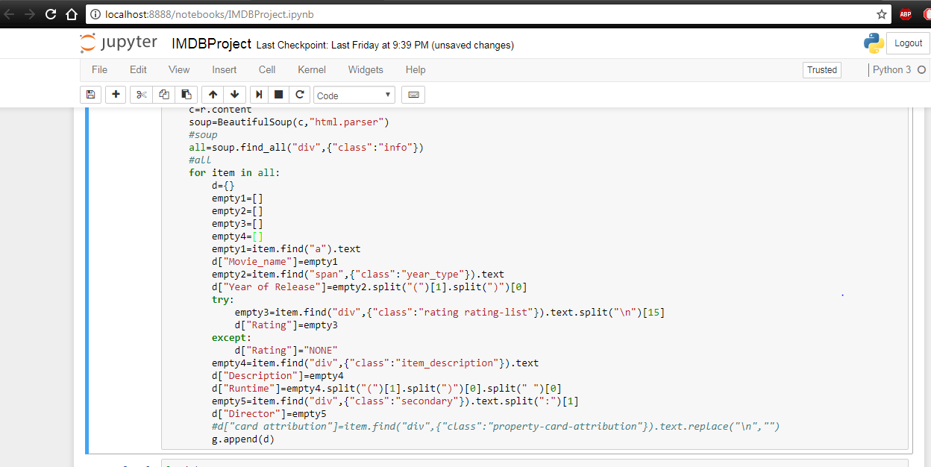
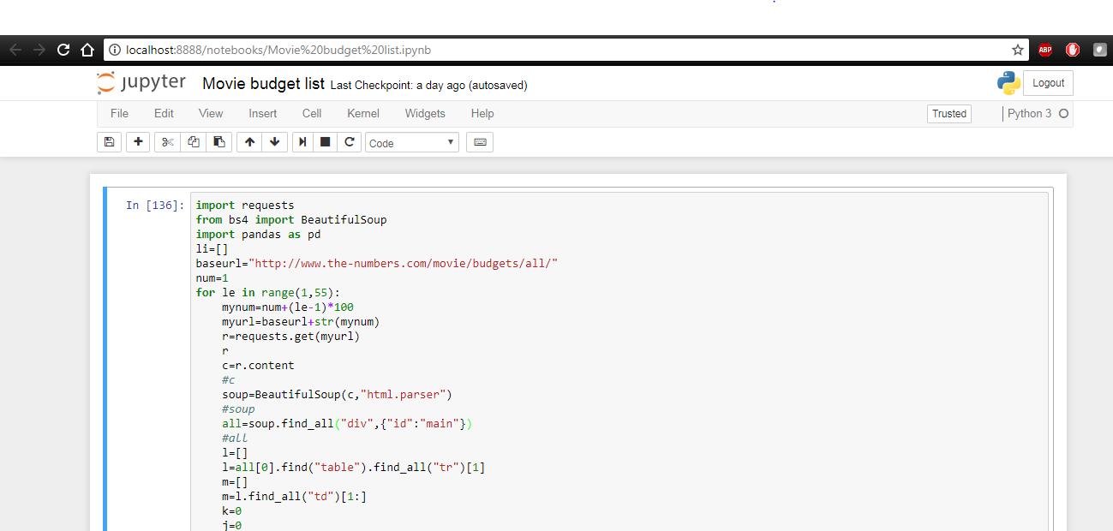
Python code used for web scraping

Slide 7
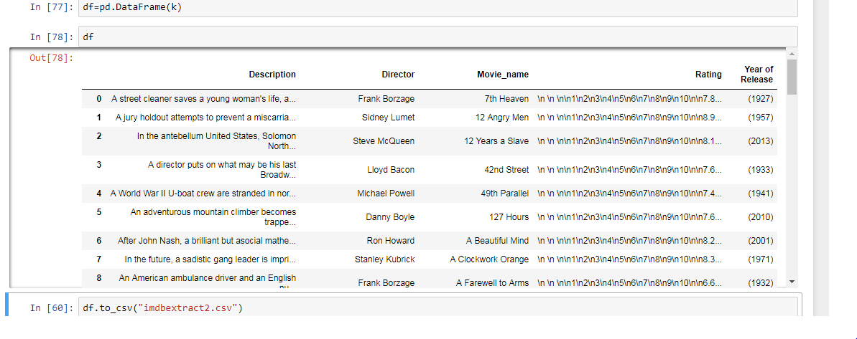
Major challenges
The code had to be modified considerably everytime we scrape data from a new website.
The data had to be cleaned to remove special symbols such as $,(),\n and strings such as mins etc.
A typical unclean data looks like the snapshot on the right

Slide 8
Data cleaning
We used python for cleaning most of the data during web scraping
Still for remaining cleaning process we used Excel to do final clean up of data.

Slide 9
Manual work to get appropriate data
We used excel to clean some special symbols such as $,”” etc in columns cells
To consolidate data from multiple sources we used Microsoft excel.
Consolidation of multiple sources induced duplicate values in few cells which was removed from excel as part of cleaning process.

Slide 10
How our clean data looks like..

Slide 11
Deciding on to data models (comparison)

Slide 12
Naïve bayes model output

Slide 13
Main findings

